Slide 1
The Problem
Low engagement:
According to gallup: 66% of students report feeling unengaged in class
Low understanding
It is generally accepted that class materials take a lot of time to read

Slide 2
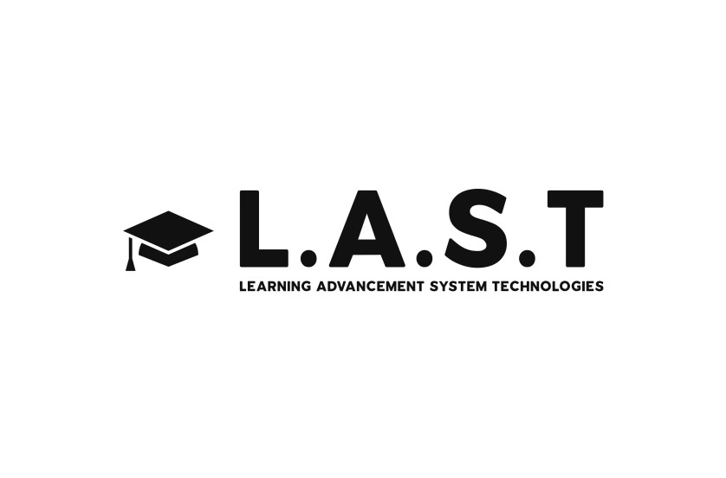
The Solution

Slide 3
The Product
Adaptive Learning
Assesses student’s existing knowledge about the subject matter of the next class
Class Engagement
Understanding topics before class-time makes them easier to discuss

Slide 4
How it Works
Assessments
Measuring current knowledge
Educational Resources
AI-Powered tutor guides students to help
Provide data to professors

Slide 5
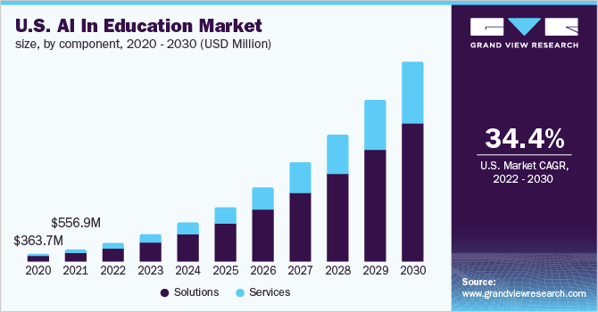
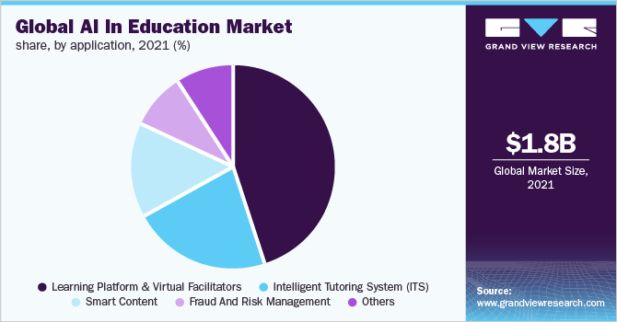
The Market

Slide 6
The Target Market
126 Colleges in Ohio
Sold to Institutions

Slide 7

The Competition
 | Learning Resource Suggestions | Analytics for students | In-Depth analytics for professors | Pre-learning to gauge knowledge | AI-Powered Tutoring
L.A.S.T
Blackboard
DreamBox
Knewton
These tools are complementary: they can be used together to create more value

Slide 8
The Revenue
School pays $5/student/month
~17,000 students per school
Schools give license to ~17% students
$14,450
College / Month

Slide 9
The Costs
Year 1:
Development and launch
Year 2:
Increase Adoption Rate
Year 3:
Breakeven
$100,000 spent
6 months developing
Add 1 College/ 2 months
Have schools adopt to 20% of classes
Revenue covers costs
Focus on Adoption Rates

Slide 10





The Team
Erik Franks:
Student of Marketing
Co-founder of an IT consulting company
Meet Thakker:
Student of Computer Science
Vice-President of the Entrepreneurship Club at CSU
Siri Pathapati:
Student of Finance and Economics
Serial Entrepreneur
Fred Franks:
Student of IT
Co-founder of an IT consulting company
Hasritha Puthalapattu:
Masters in MIS
Product Strategist

